Slide 1
1. Managing Risk, Ch. 7, T1 2. Reducing Project Duration, Ch. 9, T1
M K Hamirwasia
WILPD

Slide 2
AE/DE/MM/ES/POM ZG523-Merged
Project Management
Lecture No. 16

Slide 3
Managing Project Risk, Ch. 7, T1

Slide 4

Managing Project Risk
Introduction to the Topic
Risk Management Process
Risk Identification
2. Risk Assessment
Risk Response Development
* Contingency Planning
* Handling Risks
* Contingency Funding and Time Buffers
Risk Response Control
* Change Control Management
Case 7.1 Discussion

Slide 5
Introduction
What is Risk?
Project Risk is defined by PMI as 'an uncertain event or condition that, if it occurs, has a positive or negative effect on a project’s objectives'.
Anything that might occur to change the outcome of a project activity, we call that a risk.
A risk can be an event (like an earthquake) or it can be a condition (like an important part being unavailable).

Slide 6
Introduction
A risk has a cause, and if it occurs, a consequence.
Cause:
Fatal accident at the site – the work is held up for a day
Change in scope – the product has to be redesigned
Consequences: The schedule and cost of the project will be adversely affected.

Slide 7
Introduction
Even the most carefully planned project can run into trouble.
No matter how well you plan, your project can always encounter unexpected problems.
Team members get sick or quit, resources that you were depending on turn out to be unavailable, even the weather can throw you for a loop (e.g., a windstorm).
So does that mean that you’re helpless against unknown problems? No! You can use risk planning to identify potential problems that could cause trouble for your project, analyze how likely they are to occur, take action to prevent the risks you can avoid, and minimize the ones that you can’t.

Slide 8
Introduction
What is Project Risk Management?
Project Risk Management is the identification, assessment, and prioritization of risks followed by coordinated and economical application of resources to minimize, monitor, and control the probability and/or impact of unfortunate events or to maximize the realization of opportunities.
Project risk management attempts to identify and manage potential and unforeseen trouble spots that may occur during project implementation.
Good Project Risk Management depends on supporting organizational factors, clear roles and responsibilities, and technical analysis skills.

Slide 9
RISK MANAGEMENT PROCESS
Project risk management in its entirety,
includes the following six process groups:
Planning risk management
Risk identification
Performing qualitative risk analysis
Performing quantitative risk analysis
Planning risk responses
Monitoring and controlling risks

Slide 10
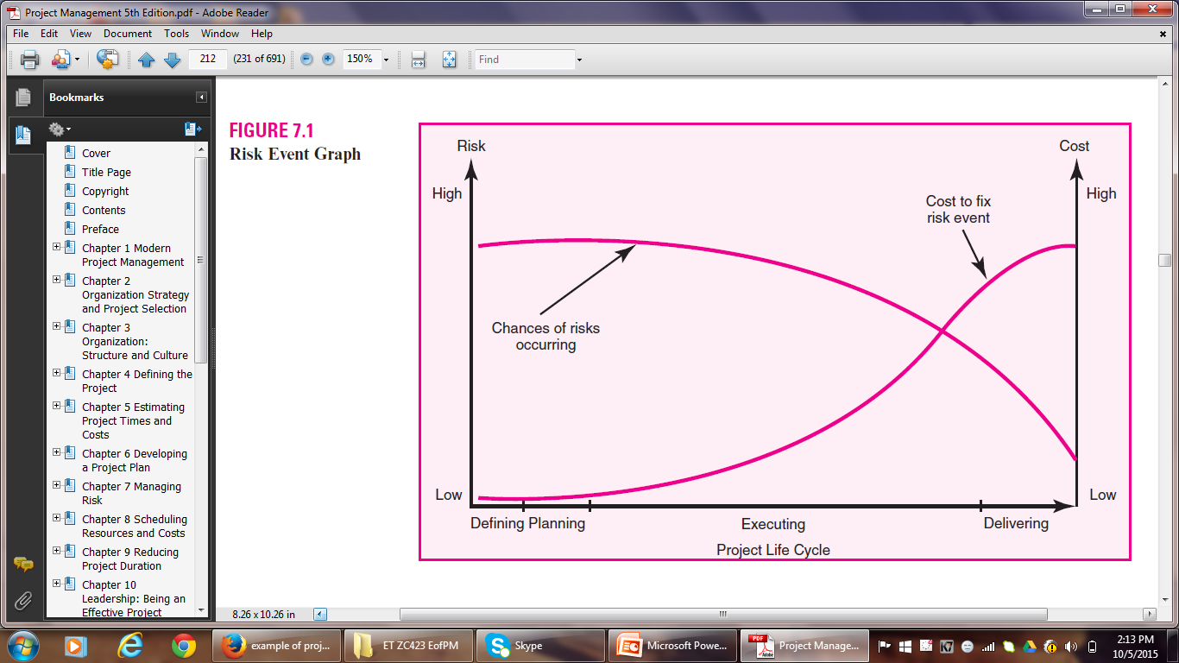
RISK MANAGEMENT PROCESS

Slide 11
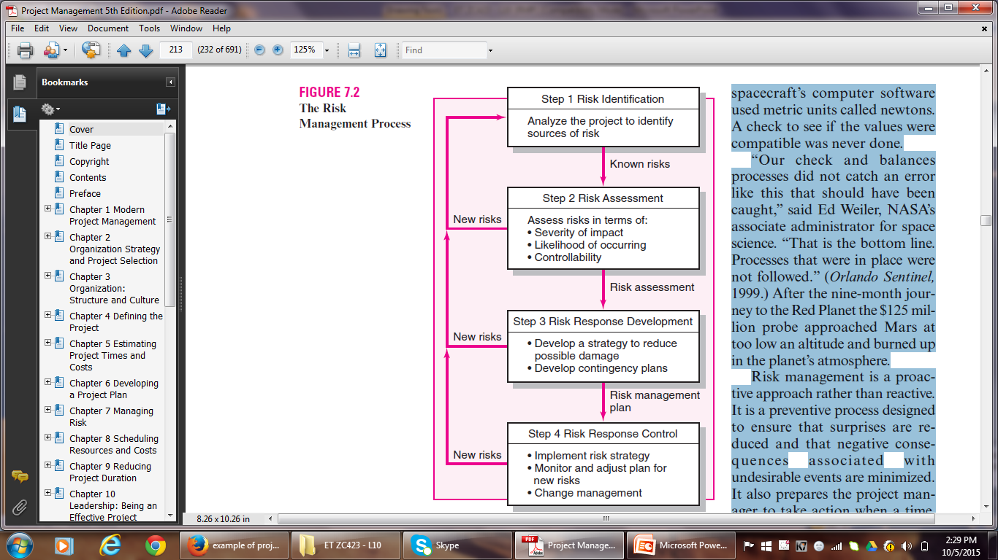
RISK MANAGEMENT PROCESS

Slide 12
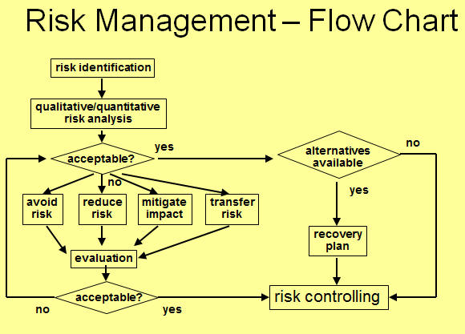
RISK MANAGEMENT PROCESS

Slide 13
RISK MANAGEMENT PROCESS
Major components of the Risk Management Process:
1. Risk Identification
2. Risk Assessment
3. Risk Response Development
4. Risk Response Control

Slide 14
Risk Identification
Risk Identification
Put in place a “risk management team” consisting of core project team members and other stakeholders.
Research has demonstrated that groups make more accurate judgments about risks than individuals do.
Brainstorm to identify potential risks.
Generate a list of potential risks.
Caution Note – Focus on actual events that could cause problems, not on the objectives.

Slide 15
Risk Identification
Important tools used to identify risks are:
Risk Breakdown Structure
Risk Profile

Slide 16
Risk Breakdown Structure
RBS lists the categories and subcategories within which risks may arise from a typical project.
Macro risks – risks that can affect the whole project
Eg.
Funding – possibility of budget being cut after the project has started
Market – new product releases by competitors
Micro risks – risks that can affect a specific section of the project or network

Slide 17
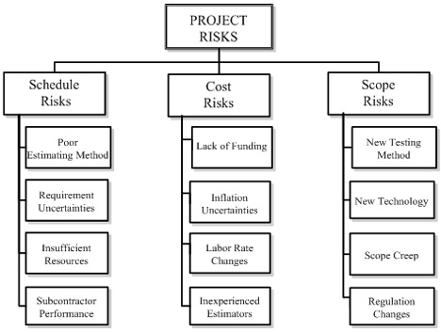
Risk Breakdown Structure

Slide 18
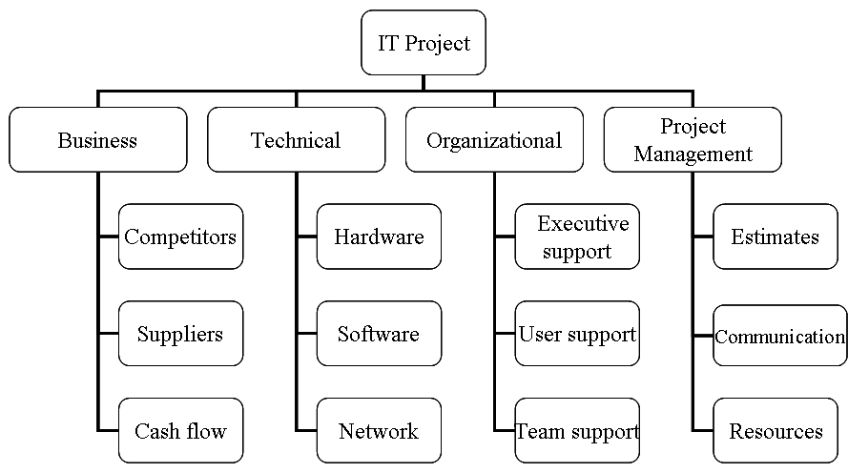
Risk Breakdown Structure

Slide 19
Risk Profile
A Risk Profile is a list of questions that address traditional areas of uncertainty on a project.
These questions have been developed and refined from previous, similar projects.
Risk profiles address both technical and management risks.
Risk profiles are generated and maintained by project office personnel.
During the post-project audit, they are updated.

Slide 20
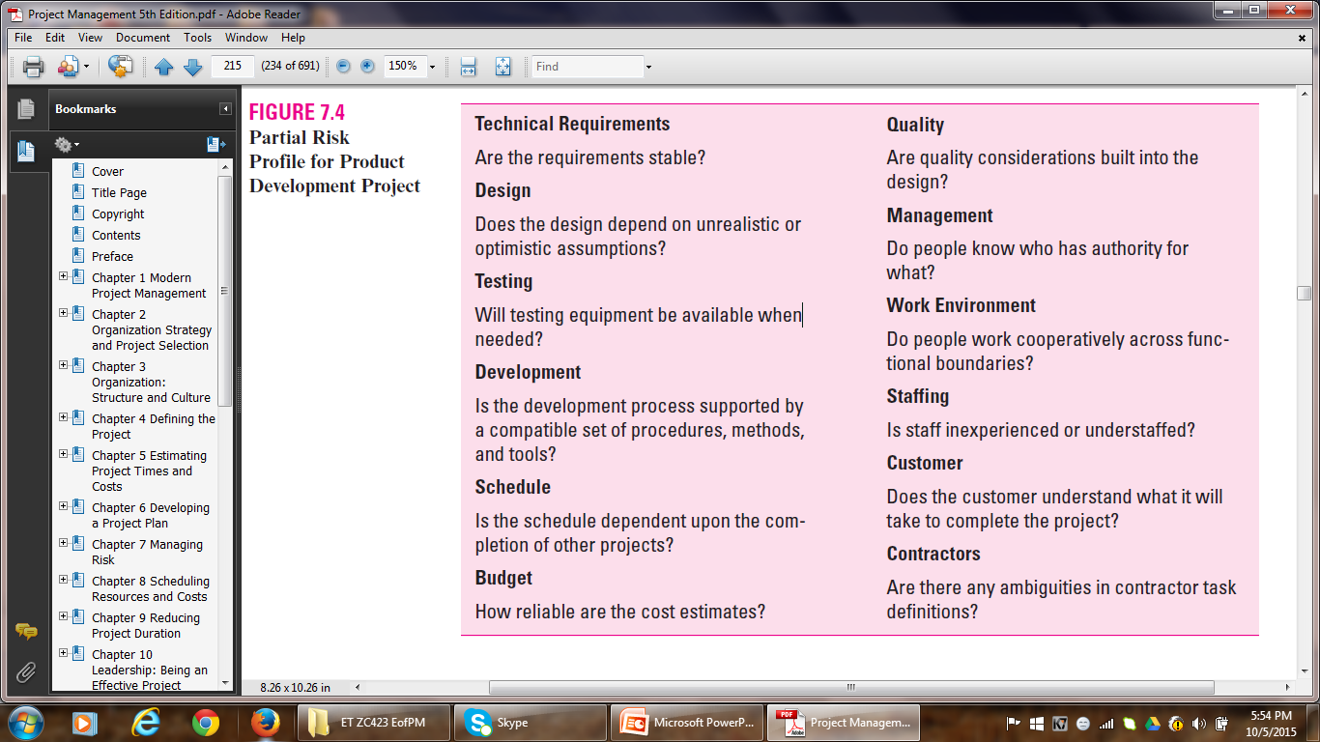
Risk Profile

Slide 21
Risk Assessment
2. Risk Assessment
Once all possible risks have been identified and the list is ready:
Sift through the list of risks.
Eliminate inconsequential or redundant risks.
Stratify worthy risks in terms of importance and need for attention.

Slide 22
Risk Assessment
Most commonly used technique for analyzing risks:
Scenario Analysis
is the assessment of the significance of each risk event in terms of:
Probability (likelihood) of the event occurring.
Impact of the event.
Eg.
Lightning
Employee turnover

Slide 23
Risk Assessment
Probabilities and impacts need to be defined in terms of either rank-order descriptors or numeric weights.
Likelihood scales:
Very Unlikely – Unlikely – Likely – Highly Likely – Almost Certainly
1 2 3 4 5
Impact scales:
Very Low – Low – Moderate – High – Very High
1 2 3 4 5
Risk Assessment Forms are used to capture scenario analyses.

Slide 24
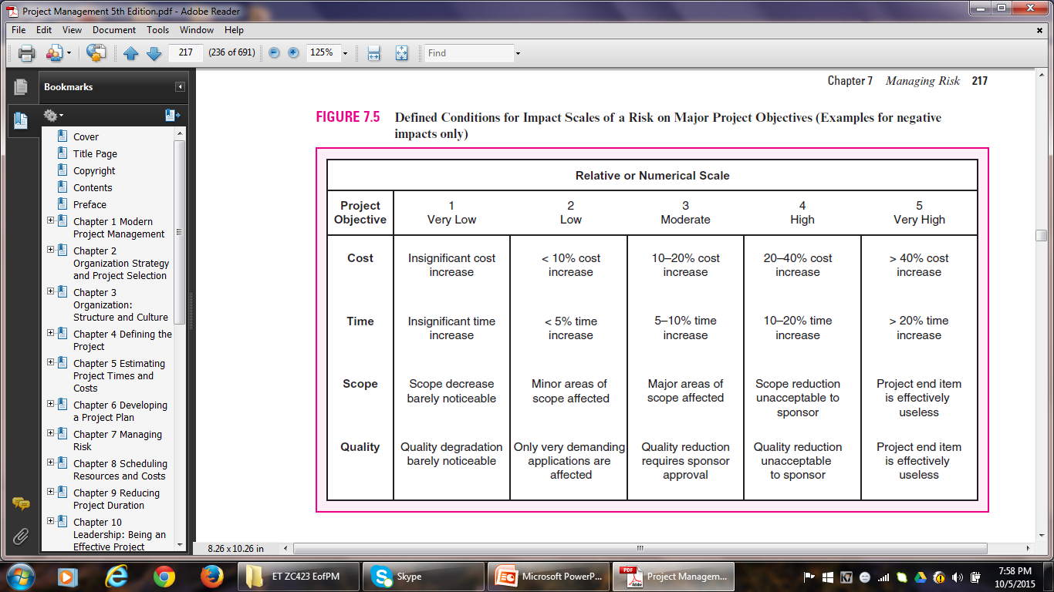
Risk Assessment

Slide 25
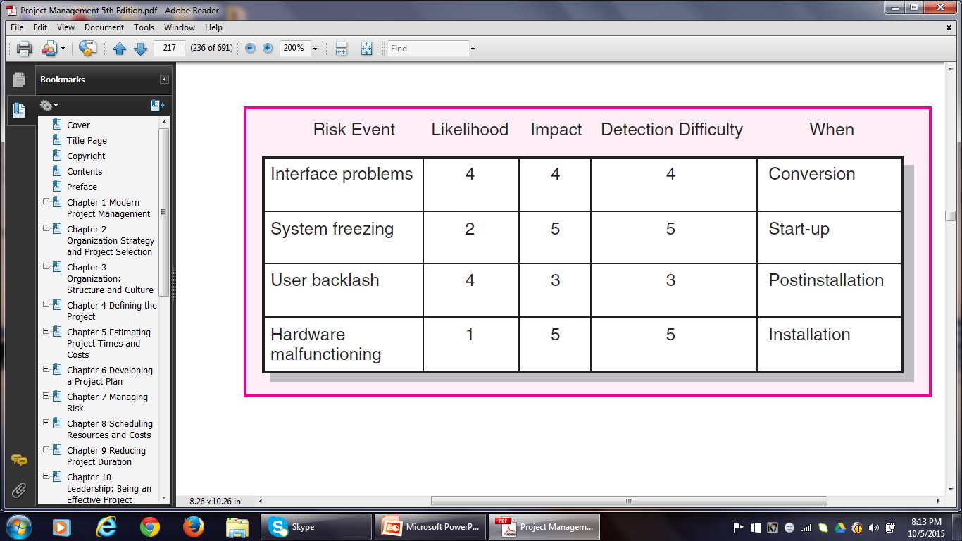
Risk Assessment Form

Slide 26
Risk Severity Matrix
The severity of different risks can be categorized into the form of Risk Assessment Matrix.
The matrix is structured around the impact and likelihood of the risk event.
The matrix is divided into Red, Yellow and Green zones.
Red zone – major risks (high impact / high likelihood)
Yellow zone – moderate risks
Green zone – minor risks (low impact / low likelihood)
The Risk Severity Matrix provides a basis for prioritization of risks.
Red zone – first priority Green zone – ignored
Yellow zone – second priority

Slide 27
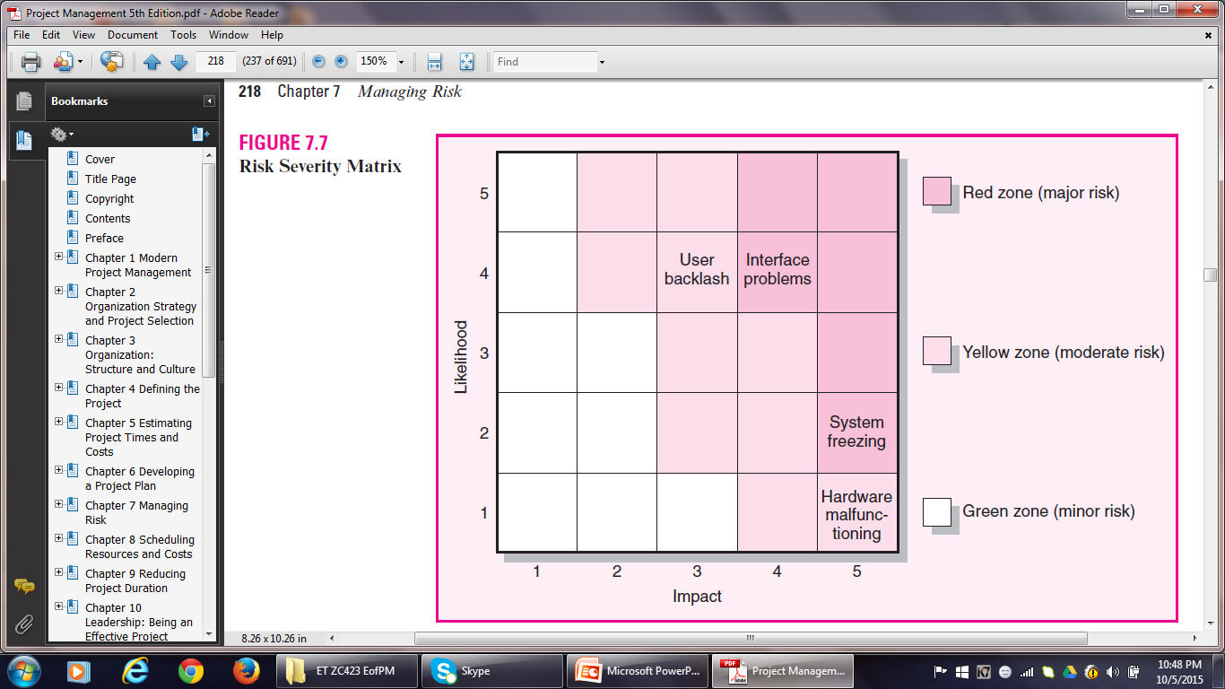

Risk Severity Matrix

Slide 28

FMEA
Failure Mode and Effects Analysis extends the risk severity matrix by including ease of detection of risk in the equation:
Impact × Probability × Detection = Risk Value
Detection is the ability of the project team to perceive that the risk event is about to happen.
Each of the three dimensions is rated according to a five-point scale.
A score of 1 would be given if even a chimpanzee could spot the risk coming.
A score of 5 would be given to events that could only be discovered after it is too late.

Slide 29
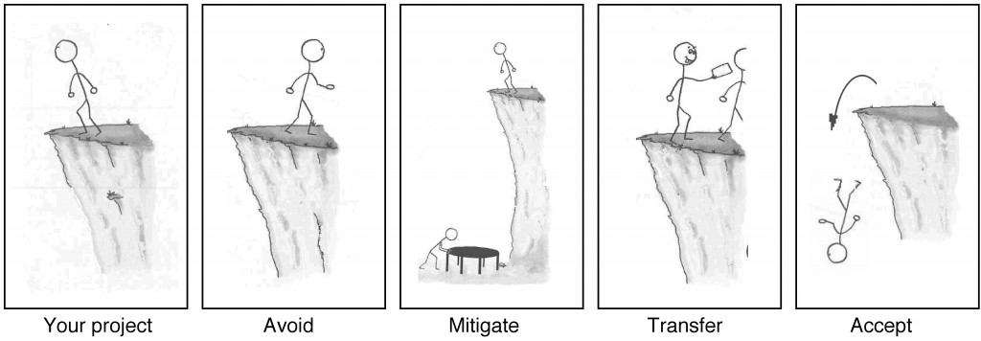
Risk Response Development
3. Risk Response Development
Risk Management Options

Slide 30
Risk Response Development
If your project requires that you work on the edge of a cliff, then there’s a risk that you could fall. If it’s very windy out or if the ground is slippery and uneven, then falling is more likely.
There are four basic ways to handle a risk.
Avoid: The best thing you can do with a risk is avoid it. If you can prevent it from happening, it definitely won’t hurt your project. The easiest way to avoid this risk is to walk away from the cliff, but that may not be an option on this project.
Mitigate: If you can’t avoid the risk, you can reduce it. This means taking some sort of action that will cause it to do as little damage to your project as possible.

Slide 31
Risk Response Development
Transfer: One effective way to deal with a risk is to pay someone else to accept it for you. The most common way to do this is to buy insurance.
Accept: When you can’t avoid, mitigate, or transfer a risk, then you have to accept it. But even when you accept a risk, at least you’ve looked at the alternatives and you know what will happen if it occurs. If you can’t avoid the risk, and there’s nothing you can do to reduce its impact, then accepting it is your only choice.

Slide 32
Risk Response Development
Mitigating Risk
Usually the first option considered.
Two strategies for mitigating risk:
Reduce the likelihood that the event will occur and/or
Reduce the impact of the event on the project
Testing and prototyping are readily used in IS projects to prevent problems from surfacing later in a project.
Some other mitigation measures:
Foreseeable problem – Measure
Vendor may not supply customized components on time – Invite the vendor to design meetings and include contract incentives for on-time delivery.
Duration and costs have been underestimated – Augment estimates to compensate for the uncertainties

Slide 33
Risk Response Development
Avoiding Risk
Technical Failure (Product Development) – Adopt proven technology instead of experimental technology
Politically unstable environment (Supply of Construction Material) – Choose an Indian supplier as opposed to a Pakistani supplier for the supply of critical materials
Likelihood of Rain (Concert) – Organize indoors
Transferring Risk
To Contractor – fixed-price contracts
Insurance – acts of God
BOOT – large international construction projects like oil refineries

Slide 34
Risk Response Development
Retaining Risk
Accept the risk
Sometimes the risk is too large to be transferred or mitigated e.g. flood
However, chances of such risks are slim
The risk is covered by developing a contingency plan to implement if the risk materializes

Slide 35
Risk Response Development
CONTINGENCY PLANNING
A contingency plan is a backup strategy that will be used if a possible foreseen risk event becomes a reality.
Risk Response – preventive in nature
Contingency Plan – reactive in nature
Contingency planning evaluates alternative work-around plans for possible foreseen events before the risk event occurs.
A project may fail in the absence of a CP, lest the undesirable event should take place.
A CP should include a cost estimate and identify the source of funding.
All CPs should be communicated to team members in advance.

Slide 36
Risk Response Development
Risk Response Matrix
RRMs are useful for summarizing how the project team plans to manage risks that have been identified.
Step 1: Identify the Response – whether to reduce, share, transfer or accept the risk.
Step 2: Identify CPs in case the risk still exists.
Step 3: Figure out what would Trigger implementation of the CP.
Step 4: Finally, assign the person who would have Responsibility for initiating the CP.

Slide 37
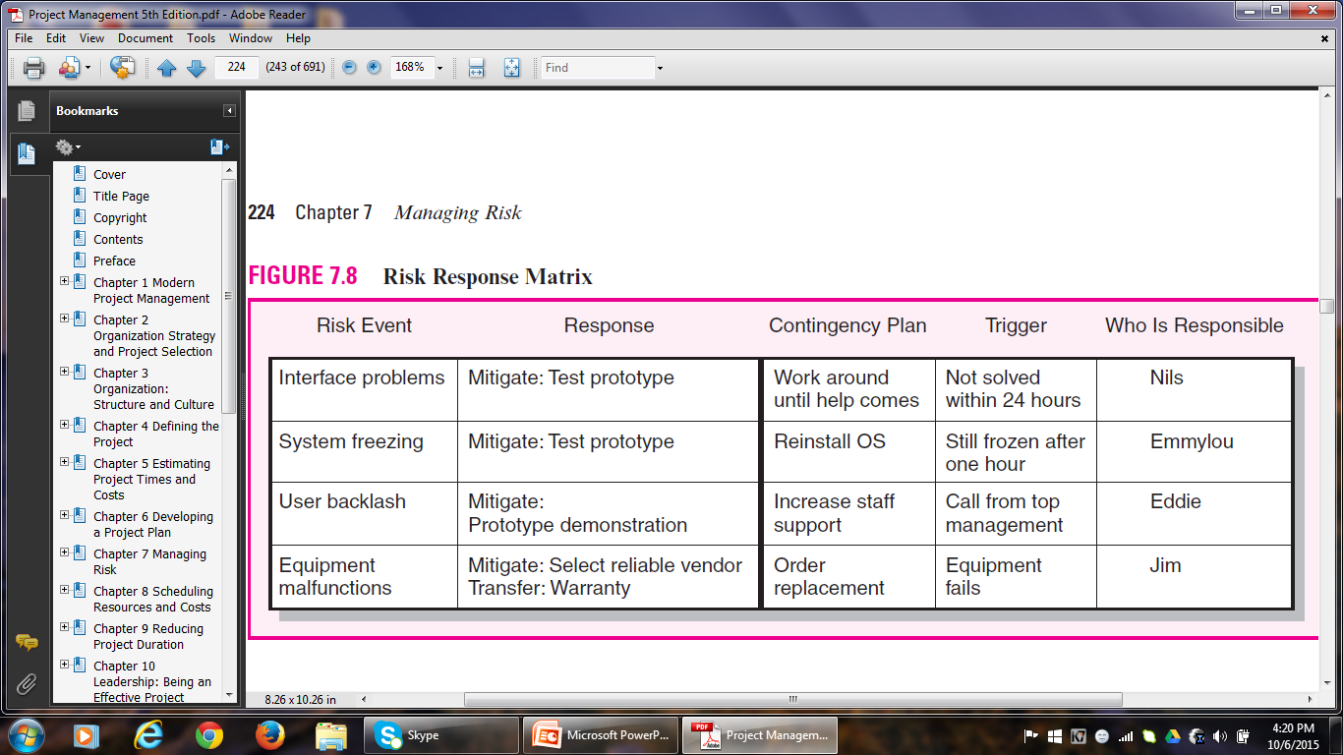
Risk Response Matrix

Slide 38
Risk Response Development
Some common methods for handling risks:
Technical Risks:
Identify the high-risk technical areas
Build models (prototypes) to test their working
Carry out testing (code is working or not!)
Design experiments
Schedule Risks:
Crash the project to get it back on track

Slide 39
Risk Response Development
Cost Risks:
Adjust for inflation, but on an item by item basis, not lump sum
Funding Risks:
Publicly funded projects are more liable to funding risks, owing to change in strategy or political changes.
Private business firms are also susceptible to funding risks owing to change in top management or priorities.
Scale back the scope of the project to the extent possible.

Slide 40
CONTINGENCY FUNDING AND TIME BUFFERS
Contingency funds are established to absorb unplanned costs – identified and unknown.
For control purposes, contingency reserve is divided into budget and management reserve funds.
Budget reserves are set up to cover identified risks.
Budget reserves are allocated to specific activities.
Management reserves are set up to cover unidentified risks.
Management reserves are allocated to risks associated with the total project.

Slide 41
CONTINGENCY FUNDING AND TIME BUFFERS
Budget Reserves
Budget reserves are earmarked for specific segments or activities of a project.
Distributing budget reserves is the responsibility of both the PM and the team members responsible for implementing the specific task.
If the risk does not materialize, the funds are removed from the budget reserve.
Budget reserves decrease as the project progresses.

Slide 42
CONTINGENCY FUNDING AND TIME BUFFERS
Management Reserves
Cover major unforeseen risks.
Applied to the total project.
Controlled by the PM and project owner.
E.g. Scope change
Technical contingencies are also placed in management reserve and controlled by the owner or top management.

Slide 43
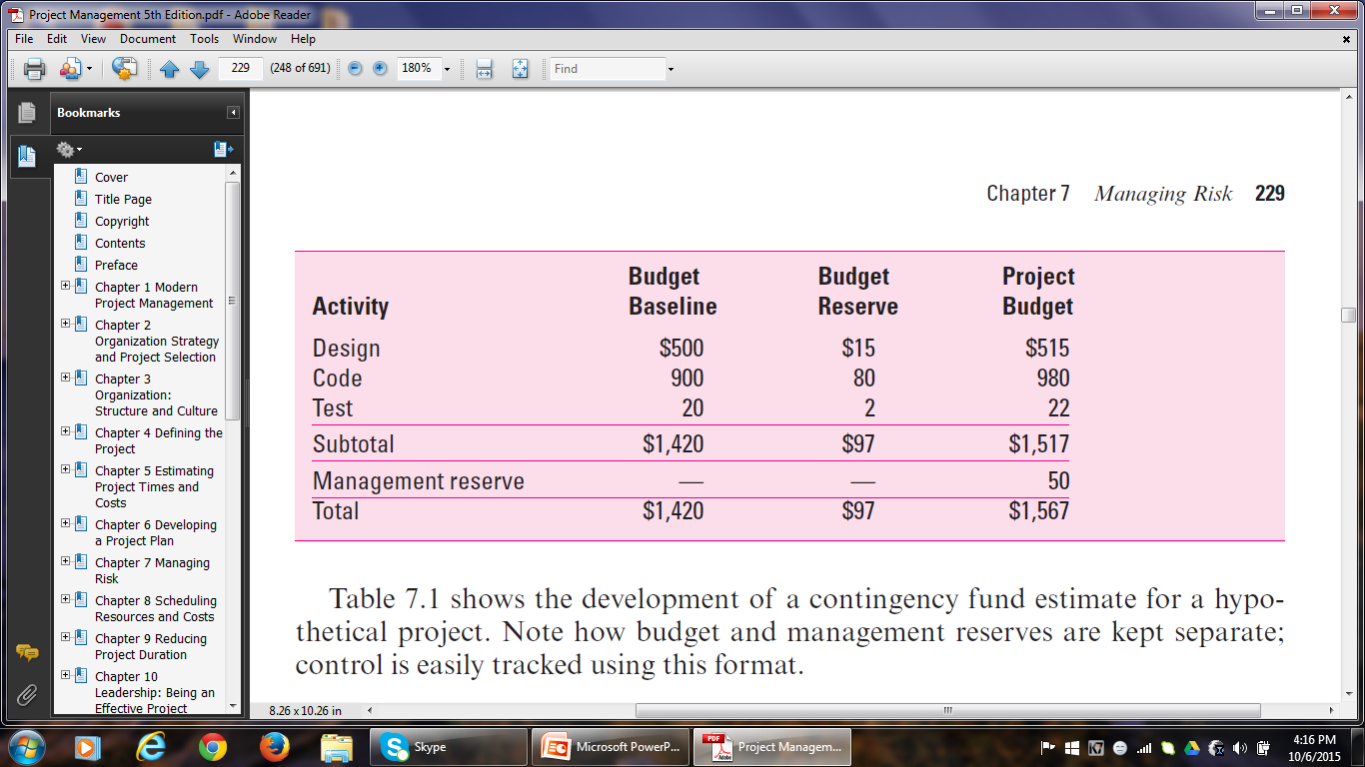
Contingency Fund Estimate

Slide 44
CONTINGENCY FUNDING AND TIME BUFFERS
Time Buffers
Time buffers are used to cover potential delays in a project.
Buffers are added to:
Activities with severe risks.
Merge activities that are prone to delays.
Non-critical activities to reduce the likelihood that they will create another critical path.
Activities that require scarce resources to ensure that the resources are available when needed.

Slide 45
RISK RESPONSE CONTROL
4. Risk Response Control
Risk control involves implementing the risk response strategy, implementing Contingency plans and looking out for new risks.
Establishing a Change Management System to deal with events that require formal changes in the scope, budget, and schedule is an essential element of risk control.
Risk control takes its inputs from a risk register.
A risk register contains all identified risks, including descriptions, category and probability of occurring, impact, responses, contingency plans, owners and current status.

Slide 46
RISK REGISTER
Risk registers are tools used by PMs and other leaders to identify potential risks that may interfere with project goals. Risk registers include key information about the risks involved with a project goal.
A risk register document, otherwise known as a risk register log, tracks potential risks specifically within a project. It also includes information about the priority of the risk and the likelihood of it occurring. A project risk register should not only identify and analyze risks, but also provide tangible mitigation measures. This way, if the risk becomes a larger threat, your team is prepared with solutions and empowered to solve the issues.

Slide 47
RISK REGISTER
It may be helpful to know common risk scenarios to decide whether a risk register is right for you and your team.
Some risk scenarios ranked by priority could include:
Low priority: Risks such as lack of communication and scheduling errors can leave projects open to scope creep and missed deliverables.
Medium priority: Risks such as unplanned or additional work can cause teams to struggle with productivity and create unclear objectives.
High priority: Risks such as data security and theft can leave your company open to revenue losses and should be prioritized.

Slide 48
RISK REGISTER
Multiple risks could arise during a new project. Anything from data security to unplanned work can risk projects going over budget and scope. Nobody wants to imagine the consequences of missed due dates, which is why it is important to identify potential risks before they happen.
Some common risk scenarios are:
Data security (information being stolen, credit card fraud)
Communication issues (inconsistencies in deliverables, missed deadlines)
Scheduling errors and delays (rushed deliverables)
Theft of materials (loss of revenue
Unplanned work (overwork and employee burnout)

Slide 49
RISK REGISTER
What is included in a risk register?
Risk identification – Risk name or ID #
The risk name, identification date, a subtitle if needed
Risk description – Brief overview of the risk
A short, high-level description of the risk, why the risk is a potential issue
Risk category – Corresponding classification
Operations, Budget, Schedule, Technology, Information, Security, Quality, Project plan
Risk likelihood – How likely it is the risk will happen
Not likely, Likely, Very likely

Slide 50
Risk Register
Risk analysis – Potential impact of the risk
Very low, Low, Medium, High, Very high
Risk mitigation – Risk response plan
A step-by-step solution on how to lessen the risk, a brief description of the intended outcome, How the plan will affect the impact
Risk priority – Level of risk compared to others
Low, Medium, High
Risk ownership – Person responsible for overseeing the solution
The person assigned to oversee the implementation of deliverables
Risk status – Progress of the risk mitigation plan
Open, In progress, Closed

Slide 51
Sample Risk Register
Risk ID: 1
Risk Description: Increased workload creates conflict with team goals
Likelihood of Risk: Low
Impact if Risk occurs: High
Severity Rating: Medium
Risk Owner: Team Manager
Mitigating Action: Schedule a meeting to discuss new requirements and audit past processes to ensure efficiency
Contingent Action: Alert PM of timing conflicts and make an action plan.
Progress on Actions: Team managers attending efficiency workshops.
Status: Open

Slide 52
Sample Risk Register
Risk ID: 4
Risk Description: Legal actions slow progress on project
Likelihood of Risk: Low
Impact if Risk occurs: Medium
Severity Rating: Medium
Risk Owner: Project Manager
Mitigating Action: Review all contracts, plans and requirements before project launches
Contingent Action: Notify project board members who will consult legal team. Follow recommended course of action
Progress on Actions: Contracts and communication forms sent out.
Status: Open

Slide 53
Another Risk Register Template
Risk Identifier: R2
Risk Category: Resources
Risk Description: Because of project team members absence, scheduled activities are not completed on time, leading to missed deadlines.
Inherent Risk: High
Risk Response: Set clear expectations, connect at regular intervals, provide coaching. Evaluate team efficiency and consider having more people.
Risk Owner: Project Manager
Risk Status: Active

Slide 54
Another Risk Register Template
Risk Identifier: R5
Risk Category: Communication
Risk Description: Lack of communication, causing confusion and negativity
Inherent Risk: Medium
Risk Response: Create communication plan that includes these sections: frequency, goal and audience. Ensure entire team understands expectations by signing form upon review.
Risk Owner: Project Manager
Risk Status: Active

Slide 55
Another Risk Register Template
Risk Identifier: R8
Risk Category: Site
Risk Description: Inadequate website testing leads to customer complaints and profit loss
Inherent Risk: High
Risk Response: Ensure related departments perform quality checks and test project site functions before updating the site.
Risk Owner: Project Manager
Risk Status: Active

Slide 56
Another Risk Register Template
Risk Identifier: R2
Risk Category: Scope
Risk Description: Incomplete project design
Inherent Risk: Low
Risk Response: Work with creative team to promote understanding of project scope. Consider design workshop or mentorship with senior-level members.
Risk Owner: Project Sponsor
Risk Status: Closed.

Slide 57
RISK RESPONSE CONTROL
Project managers need to monitor risks just as they track project progress.
Risk assessment and updating needs to be part of every status meeting and progress report system.
The project team needs to be on constant alert for new, unforeseen risks.
PM and top management should be open to new risks and problems.
Responsibility for risk should be assigned and documented.

Slide 58
CHANGE CONTROL MANAGEMENT
Change Management System involves reporting, controlling, and recording changes to the project baseline.
Most CMSs are designed to accomplish the following:
Identify proposed changes.
List expected effects of proposed change on schedule and budget.
Review, evaluate, and approve or disapprove changes formally.
Negotiate and resolve conflicts of change, conditions and cost.
Communicate changes to the affected parties.
Assign responsibility for implementing change.
Adjust master schedule and budget.
Track all changes that are to be implemented.

Slide 59
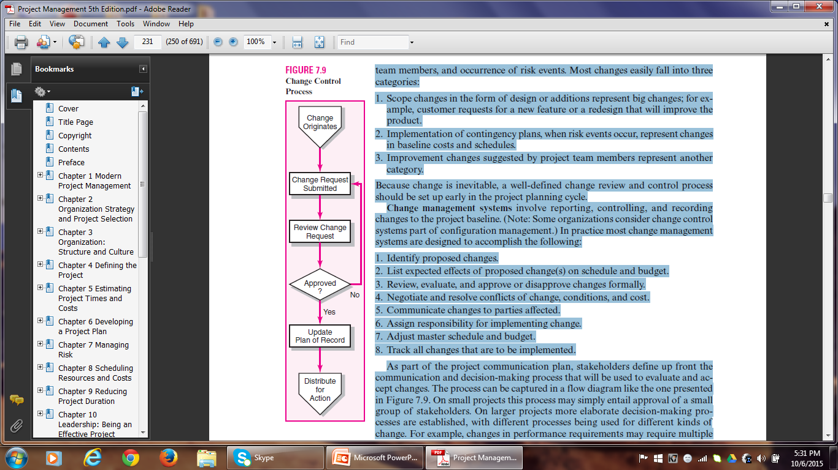
CHANGE CONTROL MANAGEMENT

Slide 60
CHANGE CONTROL MANAGEMENT
Change Request Forms and Logs are used to track proposed changes.
The benefits derived from change control systems are the following:
1. Inconsequential changes are discouraged by the formal process.
2. Costs of changes are maintained in a log.
3. Integrity of the WBS and performance measures is maintained.
4. Allocation and use of budget and management reserve funds are tracked.
5. Responsibility for implementation is clarified.
6. Effect of changes is visible to all parties involved.
7. Implementation of change is monitored.
8. Scope changes will be quickly reflected in baseline and performance measures.

Slide 61
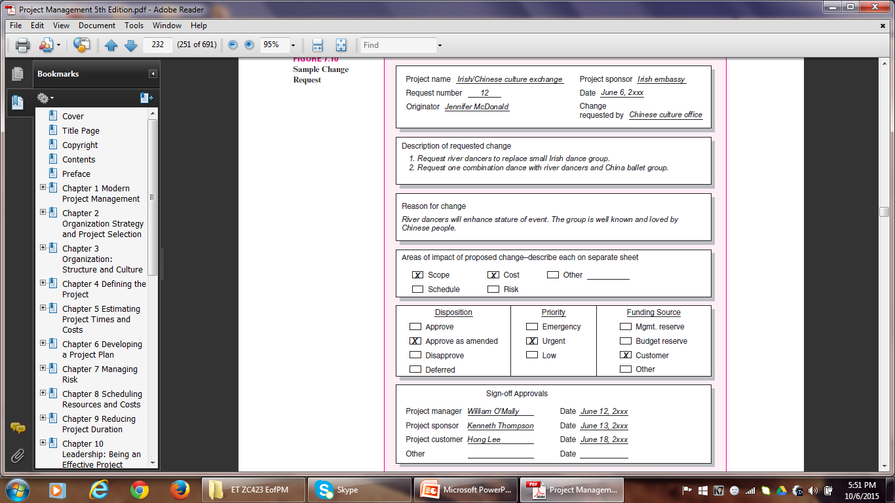
CHANGE REQUEST FORM

Slide 62
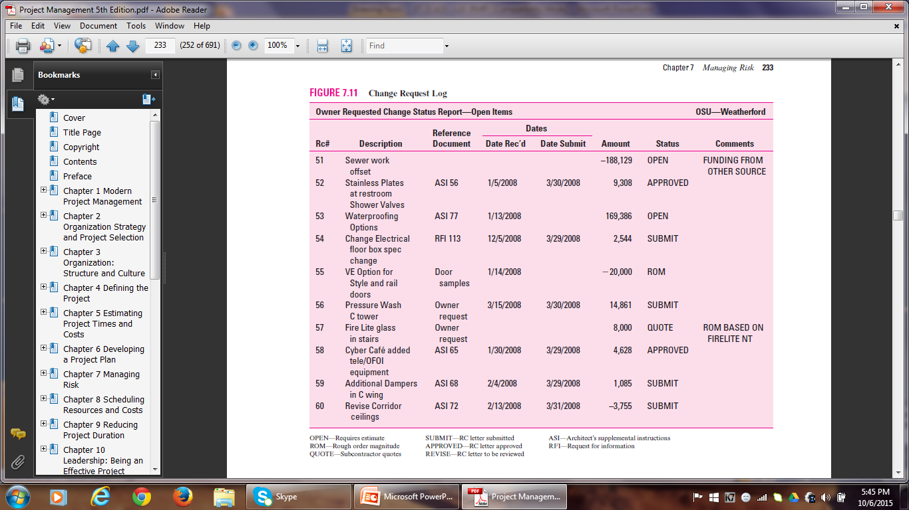
CHANGE REQUEST LOG

Slide 63
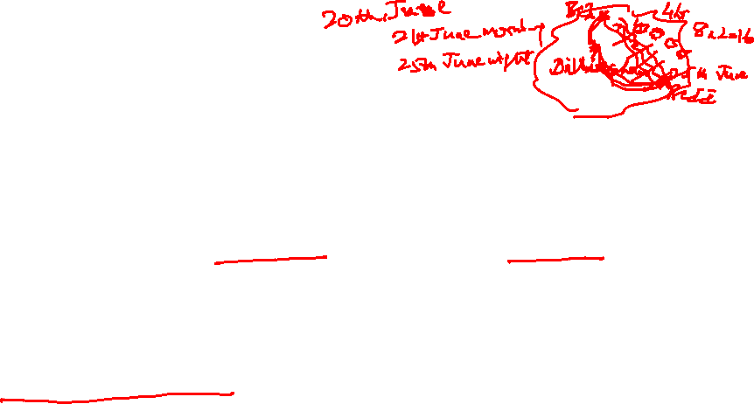
CASE 7.1
Alaska Fly-Fishing Expedition
Objective: The President of BlueNote, Inc. would like to reward her top management team by taking them on an all-expense-paid fly-fishing adventure in Alaska. Great Alaska Adventures (GAA) will be responsible for organizing and leading the expedition. The expedition will include a 5 day fly-fishing expedition down the Tikchik River system in Alaska from June 21 to 25, 2025. The cost of the expedition is not to exceed $35,000. Guests will be responsible for their own travel arrangements to and from Dillingham, Alaska and for their own fly-fishing equipment as well as clothing.

Slide 64
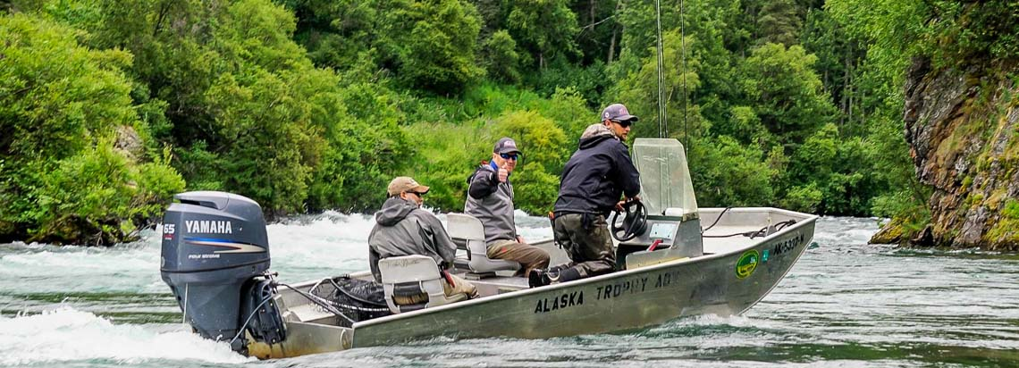

Alaska Fly-Fishing Expedition

Slide 65

Alaska Fly-Fishing Expedition
Deliverables: The deliverables for this project include the following: air transportation to and from Dillingham to and from camps I & II, river transportation that consists of 2 8-man drift boats with outboard motors, 3 meals a day for all attending guests, 4 hours of fly-fishing instruction, overnight accommodations at the Dillingham lodge in addition to 3 4-man tents with cots, bedding, and lanterns, 4 experienced river guides who are also experienced fly fisherman, fishing licenses for all guests, and digital cellular communication devices.

Slide 66
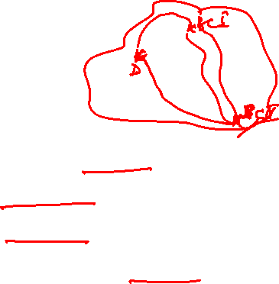
Alaska Fly-Fishing Expedition
Milestones: The milestones for this project have been broken down into four main parts.
These include:
The signing of the contract due by January 22
Guest arrival in Dillingham by June 20
Departure to Base Camp I on June 21, and
Departure to Dillingham on June 25 from Base Camp II.

Slide 67
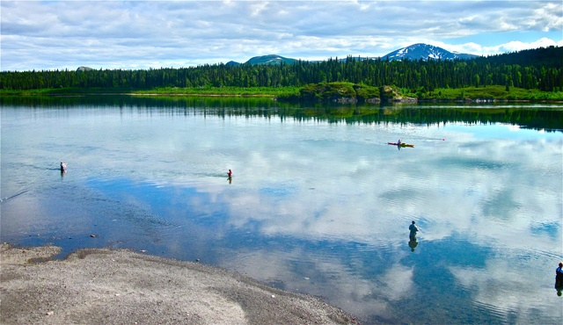
Alaska Fly-Fishing Expedition

Slide 68

Alaska Fly-Fishing Expedition
(WBS)
1.0 Alaska Fly-Fishing Expedition
1.1 Confirm number of guests attending
1.1.1 Apply and receive fishing licenses for all guests
1.2 Make overnight accommodations at Dillingham lodge for the night of
20^{the} and 25th June
1.2.1 Purchase 3 4-man tents with cots, bedding, lanterns
1.2.2 Make arrangements to feed all guests 3 times a day
1.3 Hire a pilot
1.3.1. Transport guests from Dillingham to Camp-I on 21st June
early morning
1.3.2. Transport guests from Camp-II to Dillingham on 25th June
evening
1.4 Hire river transportation
1.4.1 Hire 4 experienced river guides
1.4.2 Hire fly-fishing instructor
1.5 Obtain digital cellular communication devices

Slide 69

Alaska Fly-Fishing Expedition
Risks: There are several risks associated with this project. These may include –
Dillingham lodge unable to accommodate on specified date(s),
Lack of availability of pilot or airplane for transportation to and from Dillingham,
An instructor not available to provide 4 hours of fly-fishing instruction,
River guides unavailable for expedition,
Malfunction of cellular devices or lack of signal thereto,
Malfunction of motor boats.

Slide 70
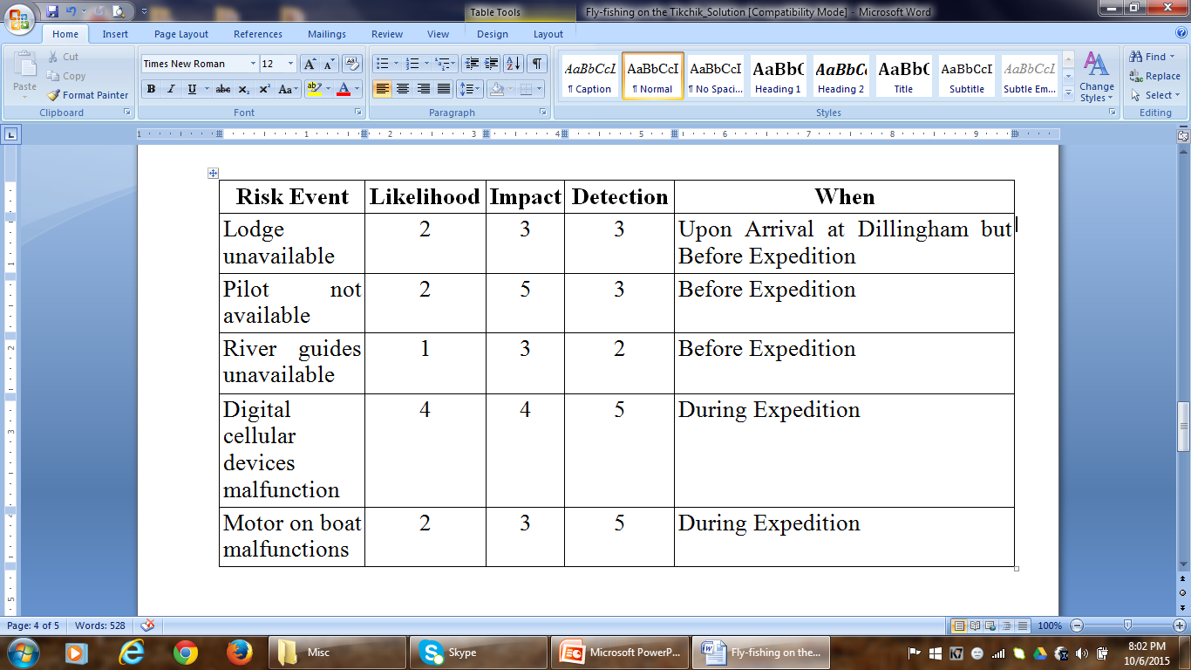
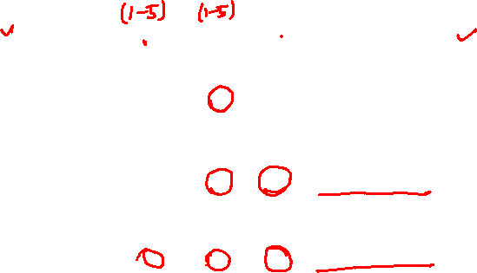
Risk Assessment Form

Slide 71
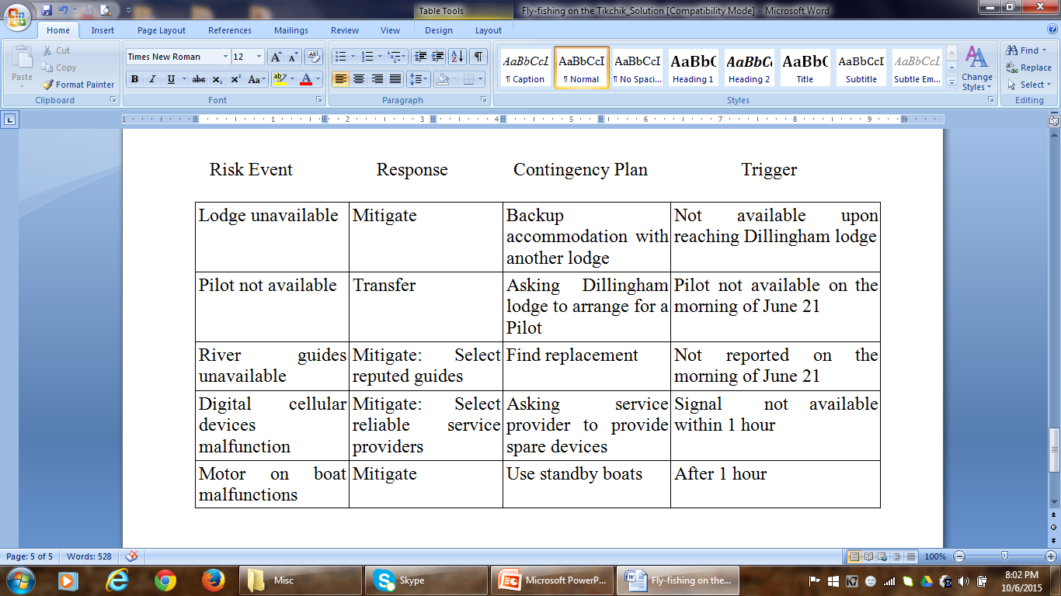
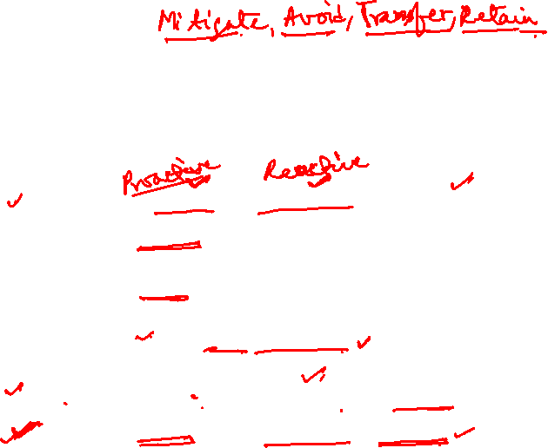
Risk Response Matrix

Slide 72
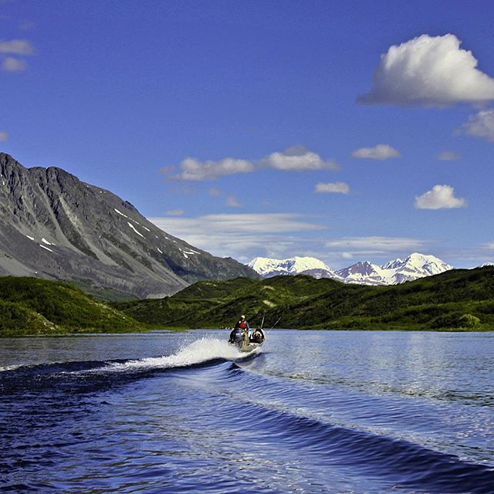
CASE 7.1 Revisited
Alaska Fly-Fishing Expedition

Slide 73

Alaska Fly-Fishing Expedition
After brainstorming, we identify the following as major risks associated with the project:
1. Disorientation (loss of direction) – this may happen due to navigation errors, navigation equipment malfunctioning or poor weather conditions.
2. Fuel shortage – due to inaccuracies in the estimate or some unanticipated occurrence.
3. Inclement weather – can lead to many problems like a boat capsizing, airplane not able to take off or land on time, tents getting uprooted…
4. Sickness or injury – during travel, fly-fishing, night stay in tents…
5. Bear Attacks – during fly-fishing, night stay in tents…

Slide 74

Alaska Fly-Fishing Expedition
Scale
1 = Very Low
2 = Low
3 = Medium
4 = High
5 = Very High

Slide 75
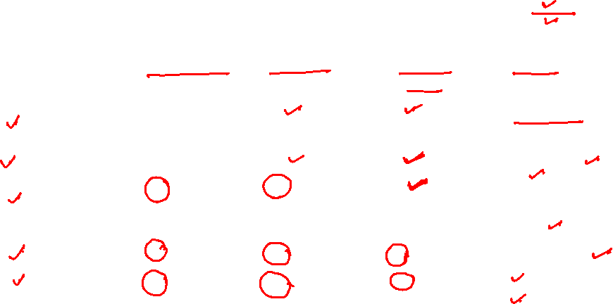
Alaska Fly-Fishing Expedition
Risk Assessment Matrix
Risk Event | Likelihood | Impact | Detection Difficulty | When
Loss of Direction | 2 | 5 | 5 | Boat Ride
Fuel Shortage | 1 | 4 | 1 | Boat Ride
Inclement Weather | 4 | 5 | 4 | Flight/ Boat Ride/ Night Stay
Sickness/ Injury | 3 | 3 | 1 | Entire Trip
Bear Attacks | 3 | 5 | 2 | Fly-Fishing/ Night Stay

Slide 76

Alaska Fly-Fishing Expedition
Detection – Likelihood – Impact
Loss of Direction
Detection of such an error is very difficult as people depend more on electronic navigation devices these days. If the device goes haywire/ malfunctions, it is very difficult to detect until the last moment.
Likelihood of happening is low since latest devices these days are very reliable and GAA has experienced river guides. But there can be data input errors and network problems with the navigation system which might give wrong directions. And guides may also find it difficult to find directions due to bad weather.
Impact will be very high as people on board are in great danger of getting lost which may delay or end the whole project.

Slide 77

Alaska Fly-Fishing Expedition
Detection – Likelihood – Impact
2. Fuel Shortage
This is easy to find as there is a meter to check the level of fuel in the boat.
GAA’s experience will come in handy in making correct estimates of the quantity of fuel required for the whole river trip which will reduce the probability of fuel shortage. Also, keeping extra cans of fuel will help.
Impact would be high as the travelers will be dissatisfied with the situation and the loss of time.

Slide 78

Alaska Fly-Fishing Expedition
Detection – Likelihood – Impact
3. Weather Conditions
With new technology, it is possible to predict weather conditions more accurately. But sudden changes in weather may occur.
Climate of Alaska is extremely cold and there can be snowstorms. Often, these may occur suddenly.
Travelers have a high risk of losing their lives, getting injured or falling sick which might affect the entire trip.

Slide 79
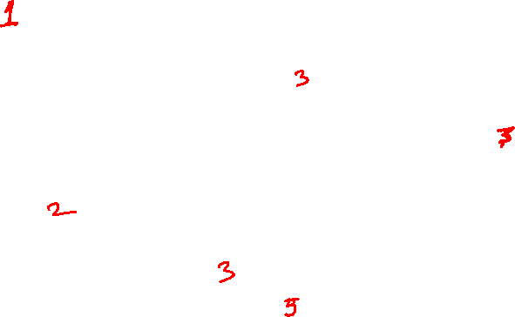
Alaska Fly-Fishing Expedition
Detection – Likelihood – Impact
4. Sickness/ Injury
Easy to detect.
May occur due to extreme cold and one being susceptible to injuries and sickness. Quite expected in a trip like this.
Even if one person falls sick/ is injured, it will affect the entire group’s mood. If it is serious, might adversely affect the trip as well.
5. Bear Attacks
Not difficult to detect.
Most bears tend to avoid people. But probability is always there as Alaska abounds in Brown/grizzly bear.
An attack could be life-threatening/paralyzing.

Slide 80

Risk Response Matrix
Risk Event | Response | Contingency Plan | Trigger | Who is Responsible
Loss of Direction | Mitigate | Get help from Office | Still lost after 01 hour | Tour Guide
Fuel Shortage | Mitigate | Refill Fuel | Fuel Indicator | Project Manager
Inclement Weather | Accept | Send for Immediate Help | Call from Management | Project Manager
Sickness/ Injury | Mitigate | Seek First Aid; Have Early Medical Check-ups | Worsening of the Condition | Traveler
Bear Attacks | Mitigate: Cook away from Tent | Call for help; Have Bonfires and Safety Tools | An Animal Attack | Tour Guide

Slide 81
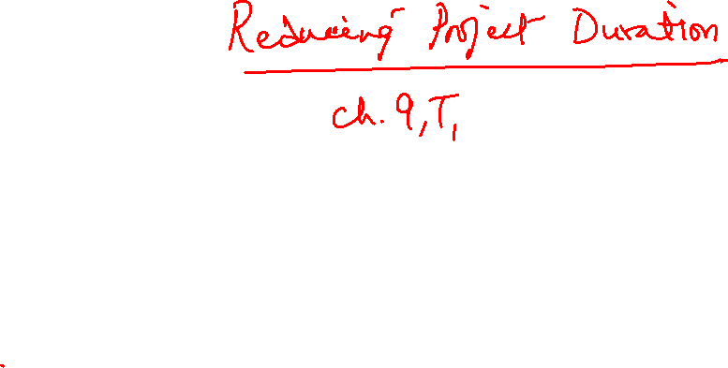


Slide 82
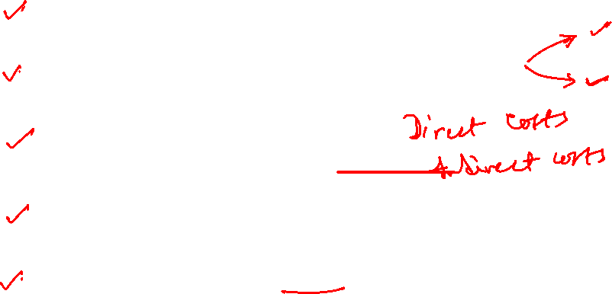
Topics to be Covered
Reasons for Reducing Project Duration
Options for Speeding up Project Completion
Project Cost–Duration Graph
Constructing a Project Cost–Duration Graph
Options for Reducing Cost

Slide 83

The Circumstances
What are the situations project managers often face?
Once you finalize the schedule, you come to know that your boss has advanced the project completion date by two months, as committed to an important client.
A couple of months in the thick of the project, you wake up to the fact that you are behind the scheduled completion date by four weeks.
Few months into the project, the top management decides that you wind up the project ASAP.
Under these circumstances, the only option with the project manager is to compress the schedule.

Slide 84
Reasons for Reducing Project Duration
Time to Market (speed and innovation)
In today’s technologically advanced and competitive world, there is a desperate need to bring new products or services to the marketplace in a flash. Eg. Electronics/ Software Industry
A six-month delay in bringing a product to market can result in a loss of 35 percent market share. At times, the product or software may become completely obsolete.
Smartphone Wars: Smartphone manufacturers the world over have reduced the time to market of new models from 12-18 months to 6-9 months.
2015: smart phone sales hit 1.5 bn
2016: smart phone sales hit 2.0 bn
2017: smart phone sales to hit 2.4 bn
Smartphone users (esp. in South Korea) change their smart phones every 14 months.

Slide 85
Reasons for Reducing Project Duration
ii) Adaptability
The global business climate keeps changing and hence companies need to quickly adapt to the new business environment for survival.
This requires speedy project management.
Eg. Indian Steel Industry
The steel industry is under tremendous pressure due to cheap imports from China. As a temporary measure, the government has hiked the import duty on steel imports from China. But, eventually, the fate of the Indian steel industry depends upon how quickly they develop newer technologies and shift to economies of scale.

Slide 86

Reasons for Reducing Project Duration
iii) Force Majeure (unforeseen delays)
Adverse weather conditions like Tsunami, earthquake, floods, cyclones, stormy weather (torrential rain, high speed winds, lightning)
The crane collapse at Mecca Grand Mosque on 11 Sept’15 is a case in point. A massive project was underway to expand the area of the mosque by 4 lakh square metres, allowing it to accommodate up to 22 lakh people at once. Bad weather is thought to be behind the crane collapse which killed 107 people. The crane was hit by lightning prior to collapsing into the mosque.

Slide 87
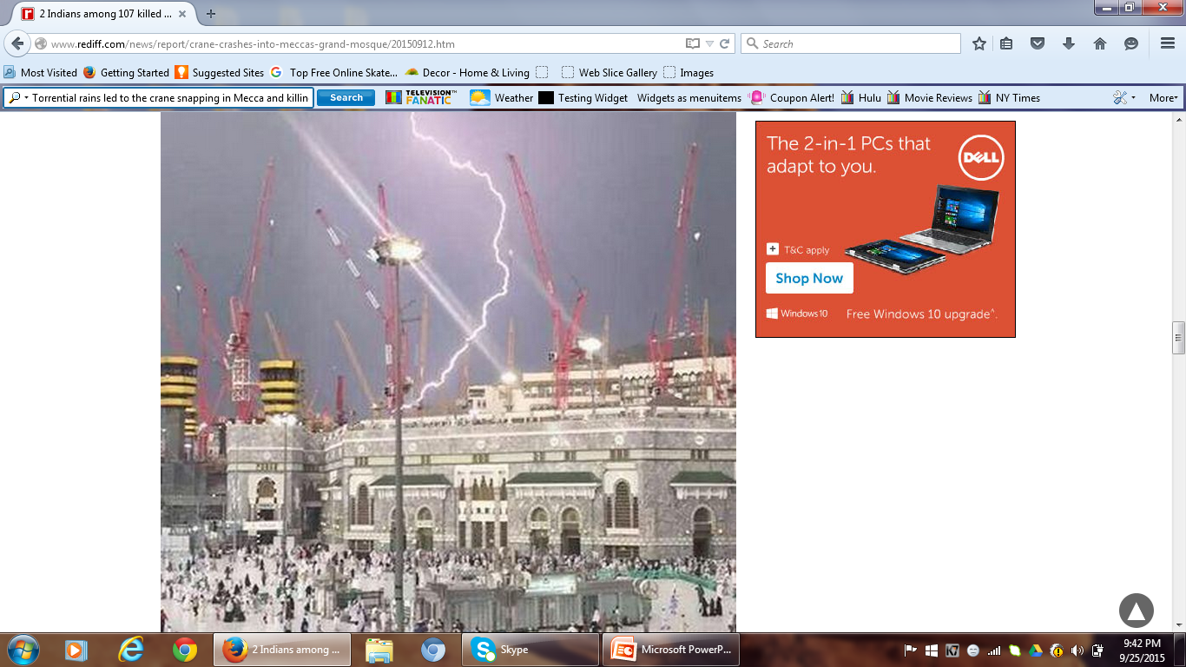
ADVERSE WEATHER CONDITIONS

Slide 88
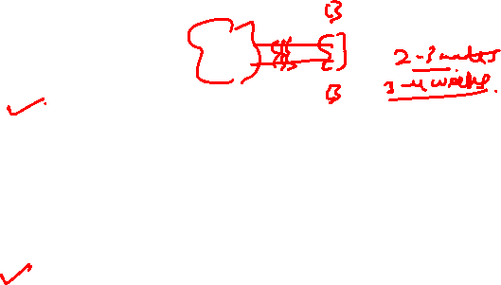
Reasons for Reducing Project Duration
iv) Incentive Contracts
If the contractor is promised an incentive for early completion of a project, he might be willing to go to great lengths to complete the project well before schedule.
v) Imposed Deadlines
Projects involving religious sentiments or facilities meant for public use are often under tight schedules. To keep the general public in good humour, a politician makes a public statement that a new facility meant for public use would be ready by a certain date, which is way ahead of the project completion date.

Slide 89

Reasons for Reducing Project Duration
Imposed Deadlines…
Likewise, it is not uncommon for bosses in software companies to announce early completion dates to important clients, turning a Nelson’s eye to the project manager’s schedule.
This leads to increased project cost.
Besides, the quality is also compromised.
vi) High Overhead Costs
Carrying out a project in an inhospitable/inaccessible region is often at the cost of high overheads for housing, transport and food.
The increase in direct costs of shortening some of the critical activities works out to be much less than the savings in indirect costs derived from decreasing the daily overhead rates. This is a situation where both cost and duration are reduced simultaneously.

Slide 90
Reasons for Reducing Project Duration
vii) Reassignment of Resources
Sometimes it becomes important to shift resources like key equipment and project personnel to new projects.
In such situations, the cost of reducing the project can be compared with the opportunity costs of not releasing key equipment or project personnel.

Slide 91
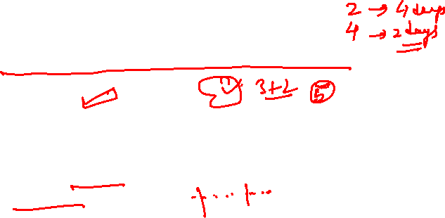
Options for Speeding up Project Completion
Options When Resources are not Constrained
Adding Resources
The most common practice for reducing project time is to add additional project personnel and equipment to activities.
However, keep in mind Brook’s Law: Adding manpower to a late software project makes it later.
Additional workers increase the communication and training requirements. Each worker must be trained in the technology, the goals of the effort, and the overall strategy.
When a task can not be partitioned because of sequential constraints, the application of more effort has no effect on the schedule. The bearing of a child takes nine months, no matter how many women are assigned.

Slide 92

Options for Speeding up Project Completion
Intercommunication among project personnel is worse. If each part of the task must be independently coordinated with each other part, the effort increases as n(n-1)/2.
Three workers require three times as much pair-wise intercommunication as two.

Slide 93
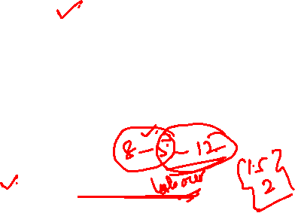
Options for Speeding up Project Completion
ii) Outsourcing Project Work
A common practice to reduce the project time is to subcontract an activity. Contractors have ample expertise and experience in finishing tasks in the minimum time possible.
It has the added advantage of freeing up scarce resources that can be assigned to a critical activity.
iii) Scheduling Overtime
Instead of adding more manpower, it is better to resort to overtime.
You also get rid of the additional costs of communication and training new project personnel.
However, it is not without disadvantages. Eg. Decline in productivity, de-motivating for salaried personnel.

Slide 94

Options for Speeding up Project Completion
iv) Establish a Core Project Team
A dedicated team of professionals is better focused to complete the assigned tasks on time.
v) Do It Twice – Fast and Correctly
Provide a quick, short-term solution in the first instance.
During wartime, pontoon bridges (wooden planks supported over small boats) are used as temporary structures in place of damaged bridges.
It is not uncommon for software companies to release subsequent versions of their software products with improved functionality and features.

Slide 95
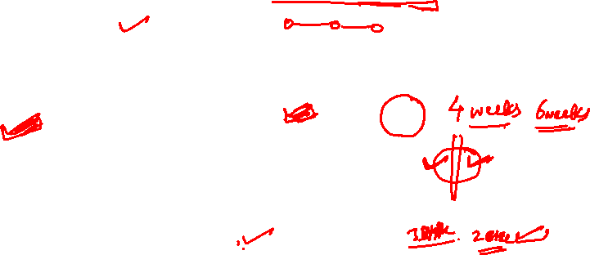
Options for Speeding up Project Completion
Options when Resources are Constrained
Fast-Tracking
Rework the network so that critical activities can be done in parallel rather than one after the other.
ii) CCPM
CCPM is designed to speed up project completion.
However, it is difficult to apply CCPM mid-way.
iii) Reducing Project Scope
It can lead to significant savings in time and cost. But the value of the project reduces. The functionality or features of the product are reduced.

Slide 96
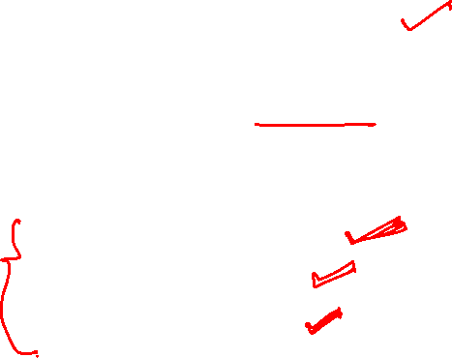
Options for Speeding up Project Completion
iv) Compromise Quality
It is possible to reduce the project duration if one is prepared to compromise with the quality.
Methods most commonly employed are:
Scheduling overtime
Outsourcing, and
Adding resources
The essence of the original plan is maintained.

Slide 97

Project Cost-Duration Graph
Project Direct Costs
Labour, materials, equipment, and sometimes subcontractors.
Direct costs are assigned directly to a work package or an activity.
Inverse relationship with duration.
Project Indirect Costs
Overhead costs such as supervision, administration, consultants, and interest.
Indirect costs can not be associated with any work package or activity, and hence the term.
Direct relationship with duration.
Indirect costs vary directly with time. Any reduction in duration should result in a reduction of indirect costs.

Slide 98
PROJECT COST-DURATION GRAPH
Indirect costs continue for the lifetime of the project.
Direct costs increase as the project duration is reduced from its original planned duration.
Identify those activities that will have the greatest impact on reducing project time at least cost.
Critical activities are searched to find the lowest direct-cost activities that will reduce the project duration.

Slide 99
Project Cost-Duration Graph
When project durations are imposed, direct costs no longer represent low-cost, efficient methods.
Any reduction in activity time adds to the cost of the activity.
When you shorten the duration,
Indirect costs – there are savings
Direct costs – there is increase in the cost
Ideally
Incremental Indirect cost savings > incremental direct cost expenditure

Slide 100
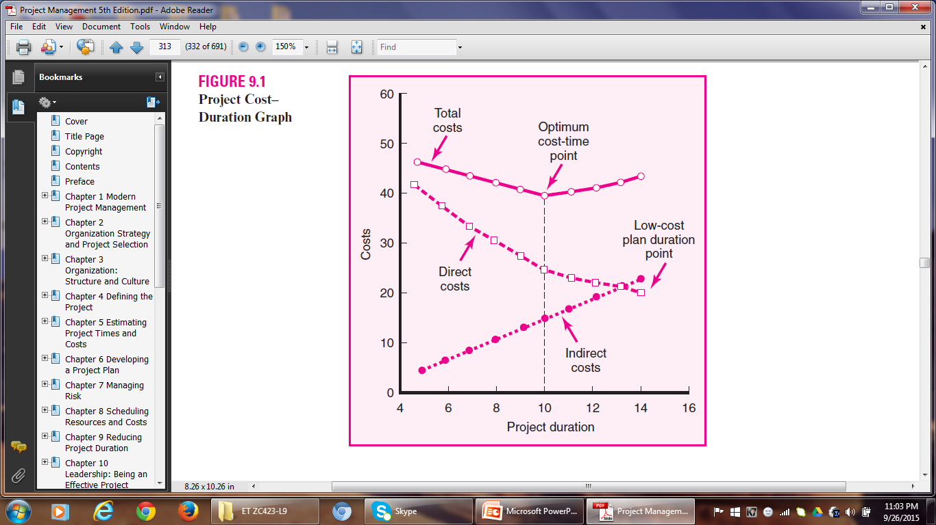
Project Cost-Duration Graph

Slide 101
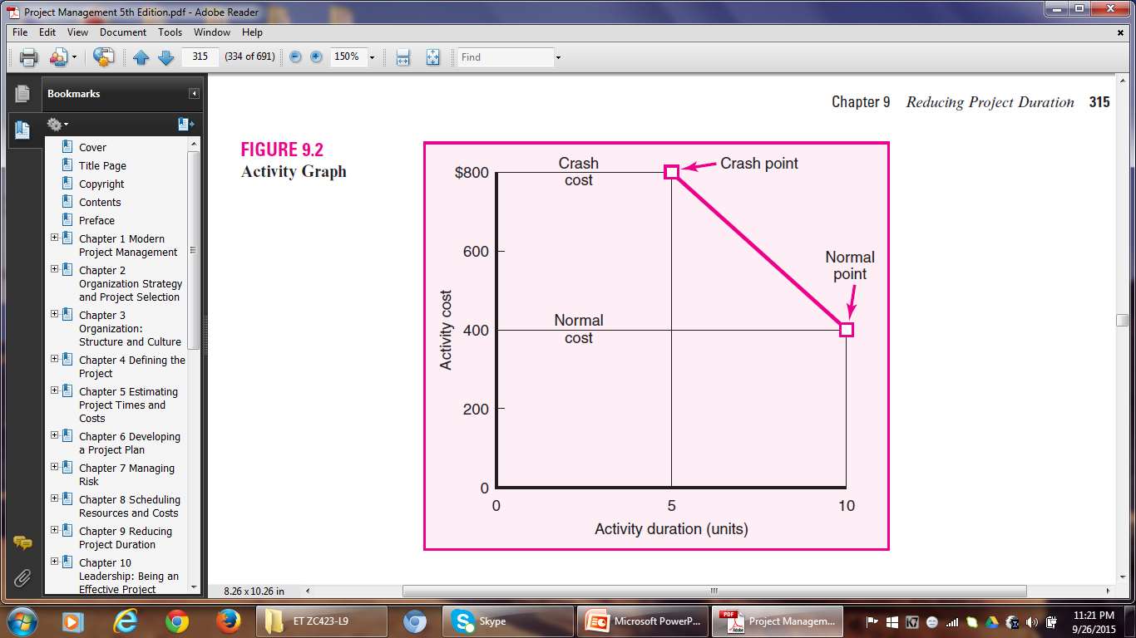
CONSTRUCTING A PROJECT COST-DURATION GRAPH

Slide 102
Constructing a Project Cost-Duration Graph
Useful Terms
Normal time for an activity represents low-cost, realistic, efficient ways for completing the activity under normal conditions.
Crashing is reducing the duration of an activity to accelerate its completion.
Crash time is the shortest possible time in which an activity can realistically be completed.
Crash cost is the direct cost of completing an activity in its crash time.
Crash Cost > Normal Cost Crash Time < Normal Time

Slide 103
Constructing Cost-Duration Graph
Identify critical activities that can be shortened with the smallest increase in cost per unit time.
The slope of the line connecting the normal point and the crash point represents the cost of reducing the time of the activity per unit of time.
A steeper slope means that it will cost more to shorten one time unit.
The activities with the least slope will cost the least to reduce the duration one unit time.
Having calculated the slope of activities, the project manager can arrive at a decision as to which activities to shorten.

Slide 104
Constructing a Cost-Duration Graph
Cost slope = Rise (on the y axis)
Run (on the x axis)
= Crash Cost – Normal Cost
Normal Time – Crash Time
= CC – NC
NT – CT
= $800 - $400
10 – 5
= $80 per unit of time

Slide 105
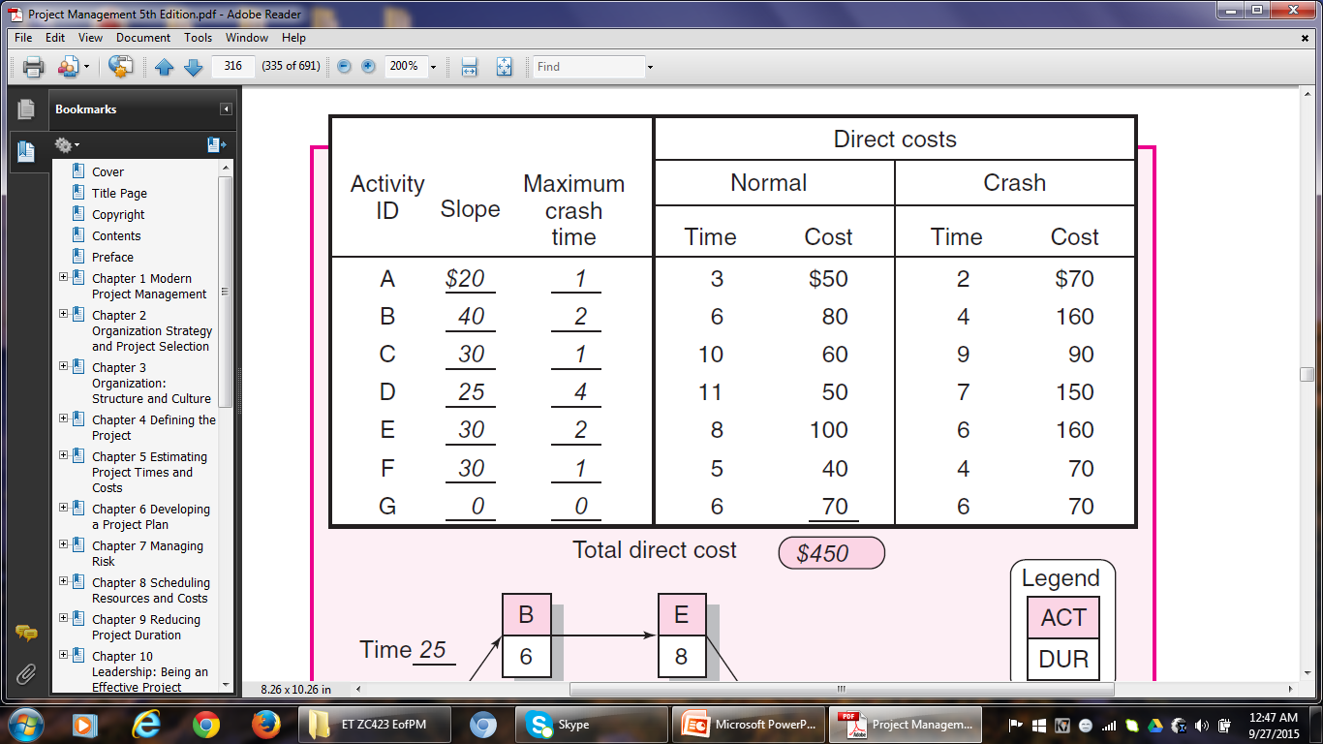
EXAMPLE

Slide 106
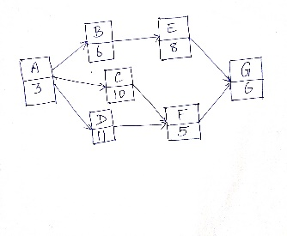

Slide 107
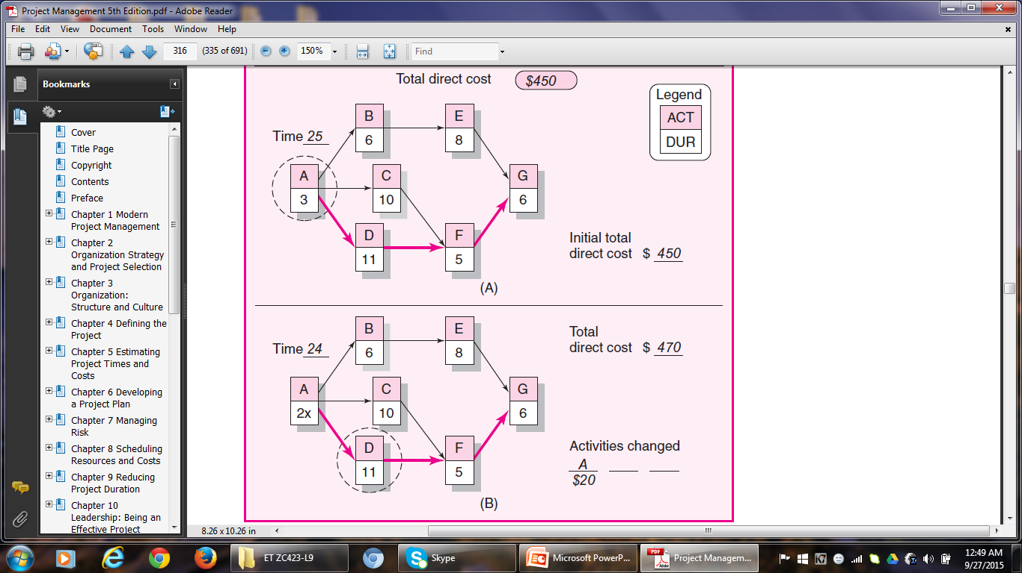

Slide 108
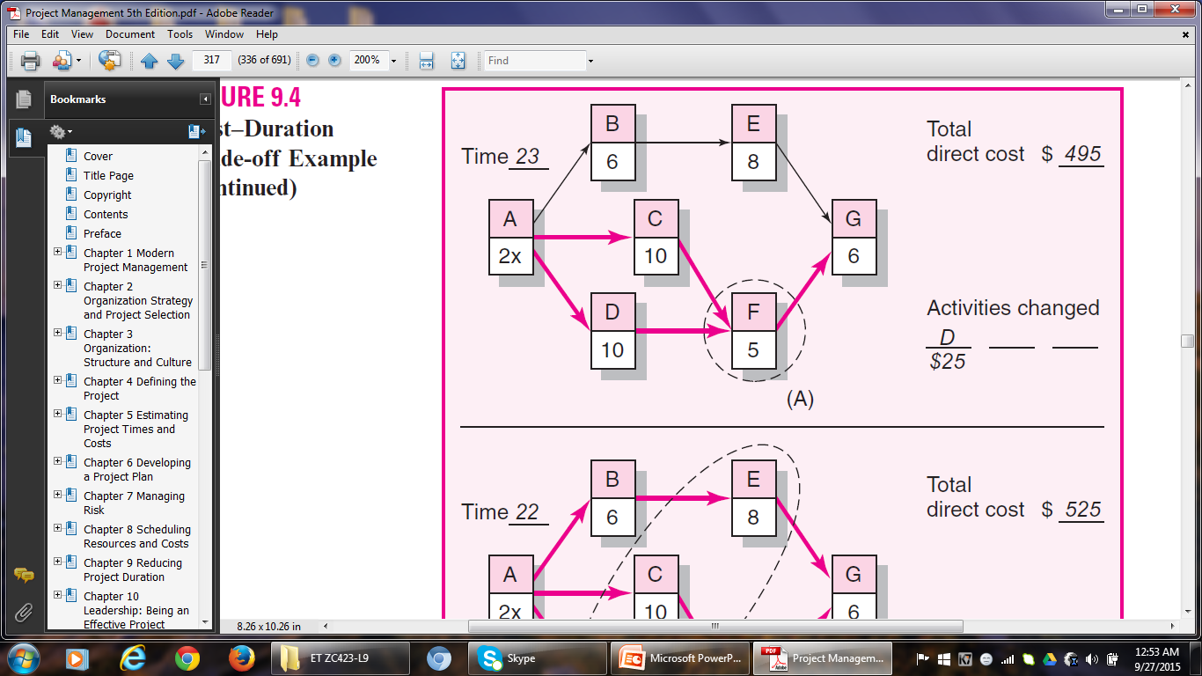

Slide 109
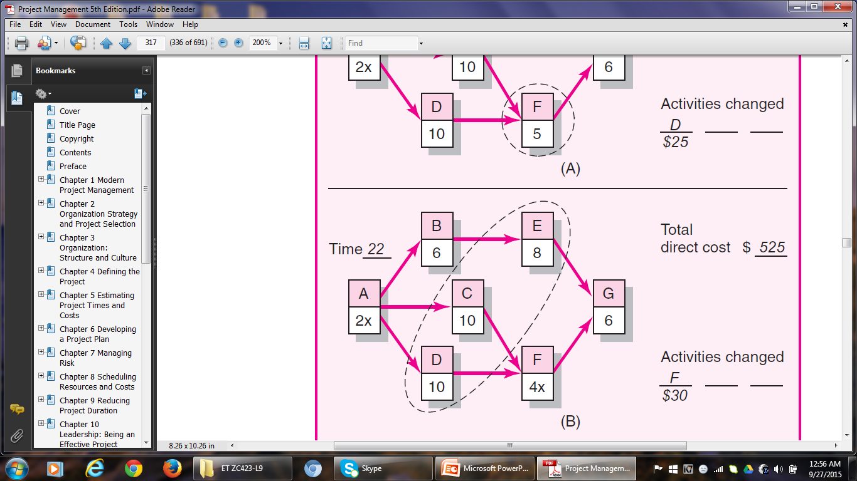

Slide 110
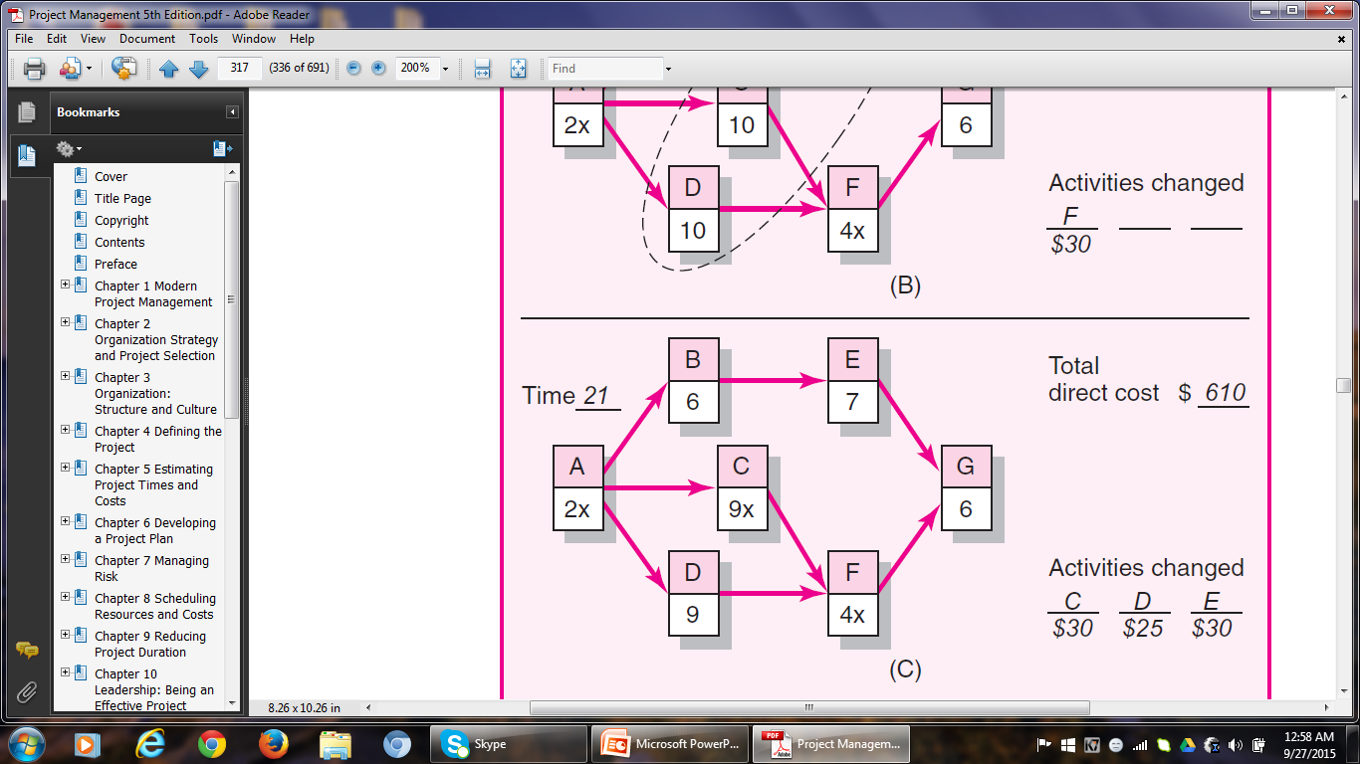

Slide 111
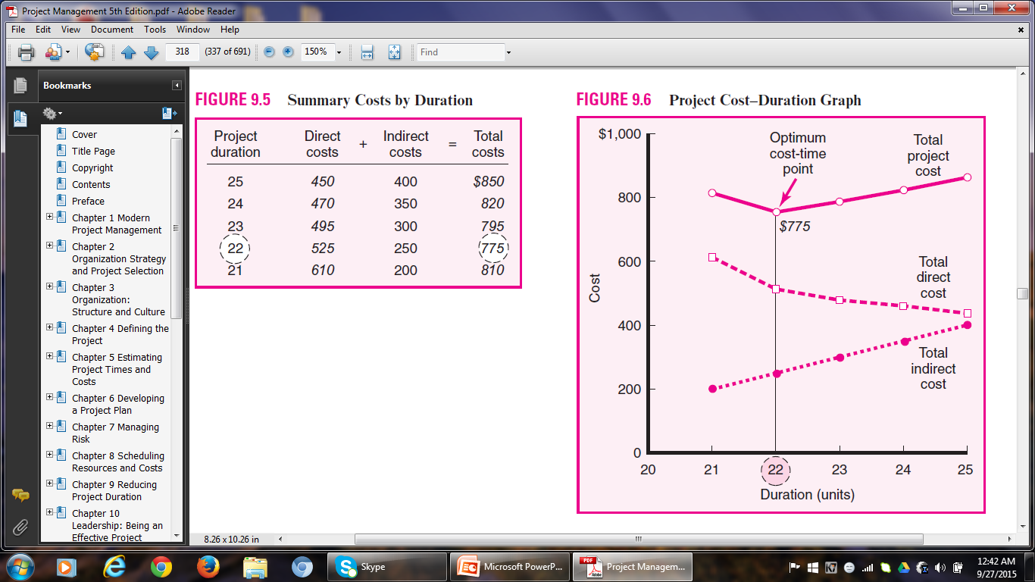

Slide 112
Reducing Project Cost
Some Reasons:
The profit margin in the case of fixed-bid projects is very tight. Hence there is a dire need to reduce cost.
Contractors purposely lower bids to secure contracts.
Sometimes there are financial incentives for cost containment.
Just as reducing project duration comes at the expense of overtime, adding additional staff, and using more expensive equipment and/or materials, cost savings can be generated by increasing the duration of a project.
A smaller workforce, less-skilled labour, and cheaper equipment and materials can be used to save cost.

Slide 113
Reducing Project Cost
Options for Reducing Project Cost
Reduce Project Scope
Eg. It is a common practice to replace location shots with stock footage on over-budget movie projects.
Ask the Customer to Own more Responsibility
Eg. Homeowners use this method to save money on home improvement projects. However, the owner should have the capability to do the tasks.
Advantage – the original scope is not altered.

Slide 114
Reducing Project Cost
iii) Outsource
Experienced subcontractors often enjoy discounts on bulk material and equipment.
They may have lower overhead and labour costs.
Eg. US Companies outsource software programming jobs to Indian firms, because of the difference in salaries of software engineers.
Discuss with Project Team Members
In the light of individual expertise and experience, team members might suggest novel ways of completing the tasks at lower costs.

Slide 115
Exercise
Q. 3. Assume the network and data that follow. Compute the total direct cost for each project duration. If the indirect costs for each project duration are $410 (19 time units), $360 (18), $310 (17), and $260 (16), compute the total project cost for each duration. What is the optimum cost-time schedule for the project? What is this cost?

Slide 116
Exercise
Act. Crash Cost Max Crash Time Normal Time Normal Cost
(Slope)
A 20 1 3 50
B 60 2 5 60
C 40 1 3 70
D 0 0 10 50
E 50 3 6 100
F 100 3 7 90
G 70 1 5 50
$470

Slide 117
Exercise
Initial Project Duration 19
Total Direct Cost $470
B
5
E
6
A
3
C
3
F
7
G
5
D
10x

Slide 118
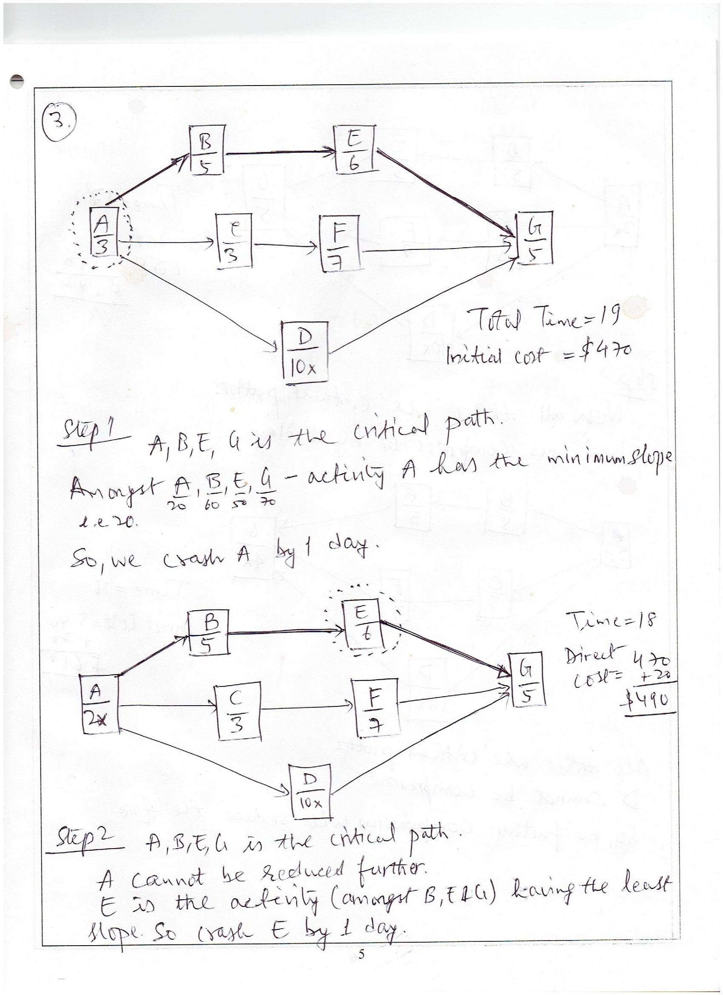
Exercise

Slide 119
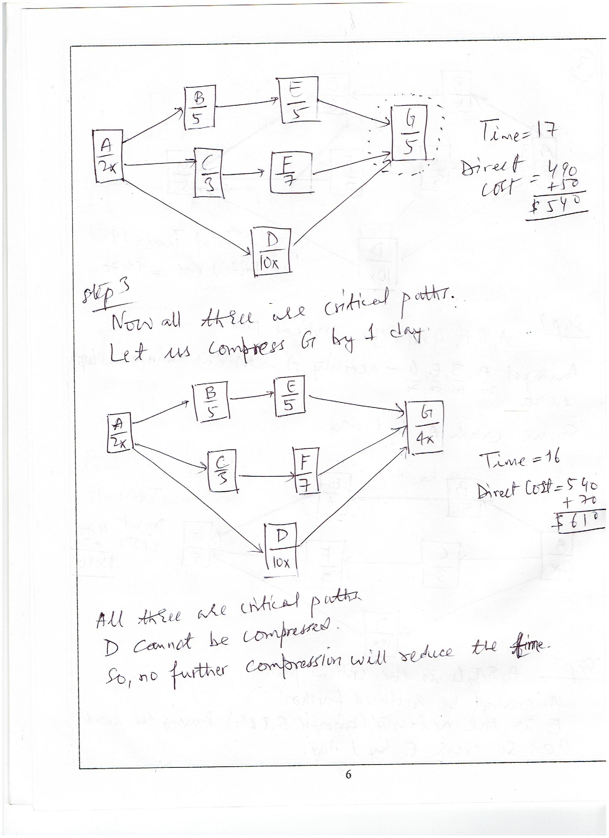
Exercise

Slide 120
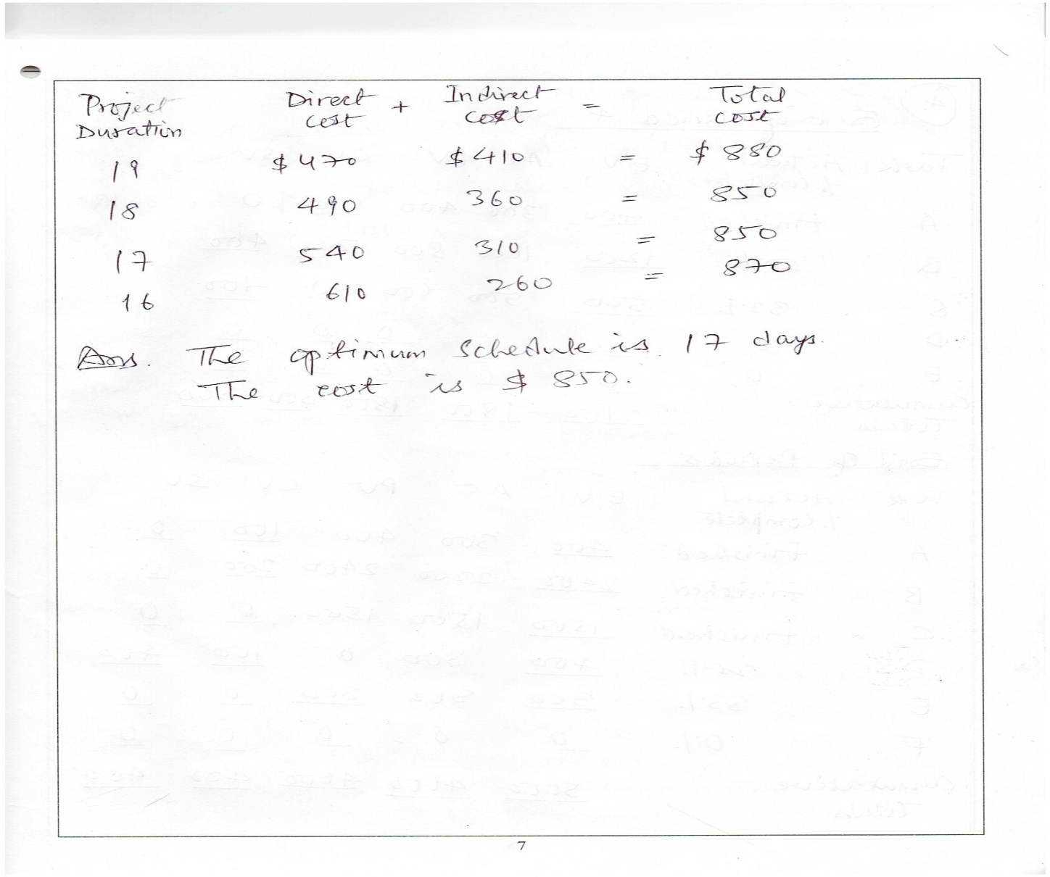
Exercise

Slide 121
Project Management
Thank You!

